Slide 1
    World Communion Sunday
October 4, 2020

Slide 2
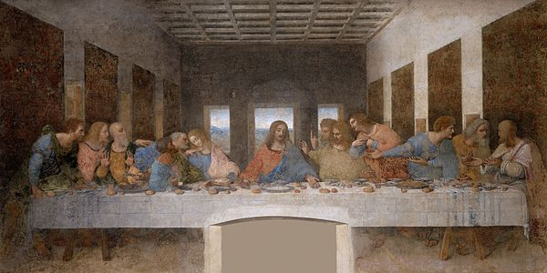
Leonardo Da Vinci - Italy, Europe
1498

Slide 3
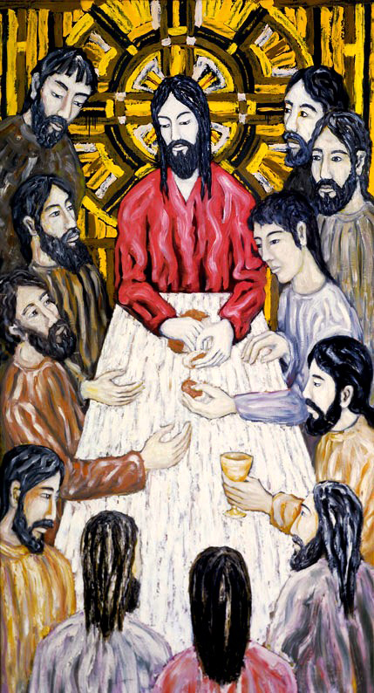
Jacek Rossakiewicz
Poland, Europe
1989

Slide 4
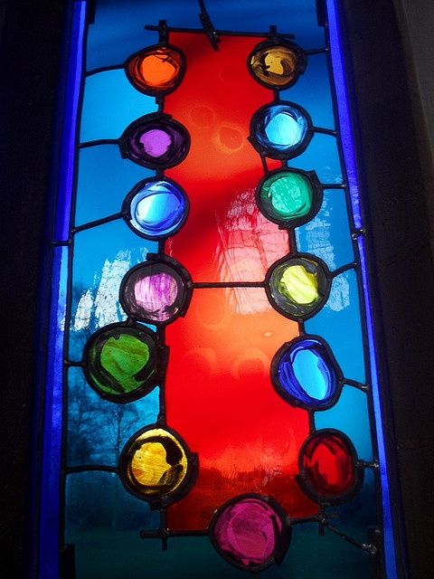
Durham Cathedral
Durham, England
United Kingdom
Europe
1980s

Slide 5
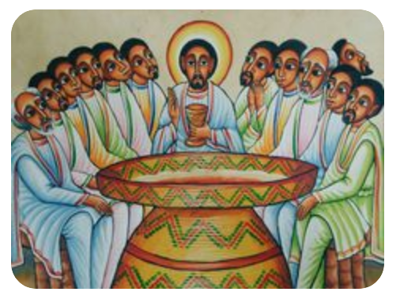
Ethiopia
Africa

Slide 6
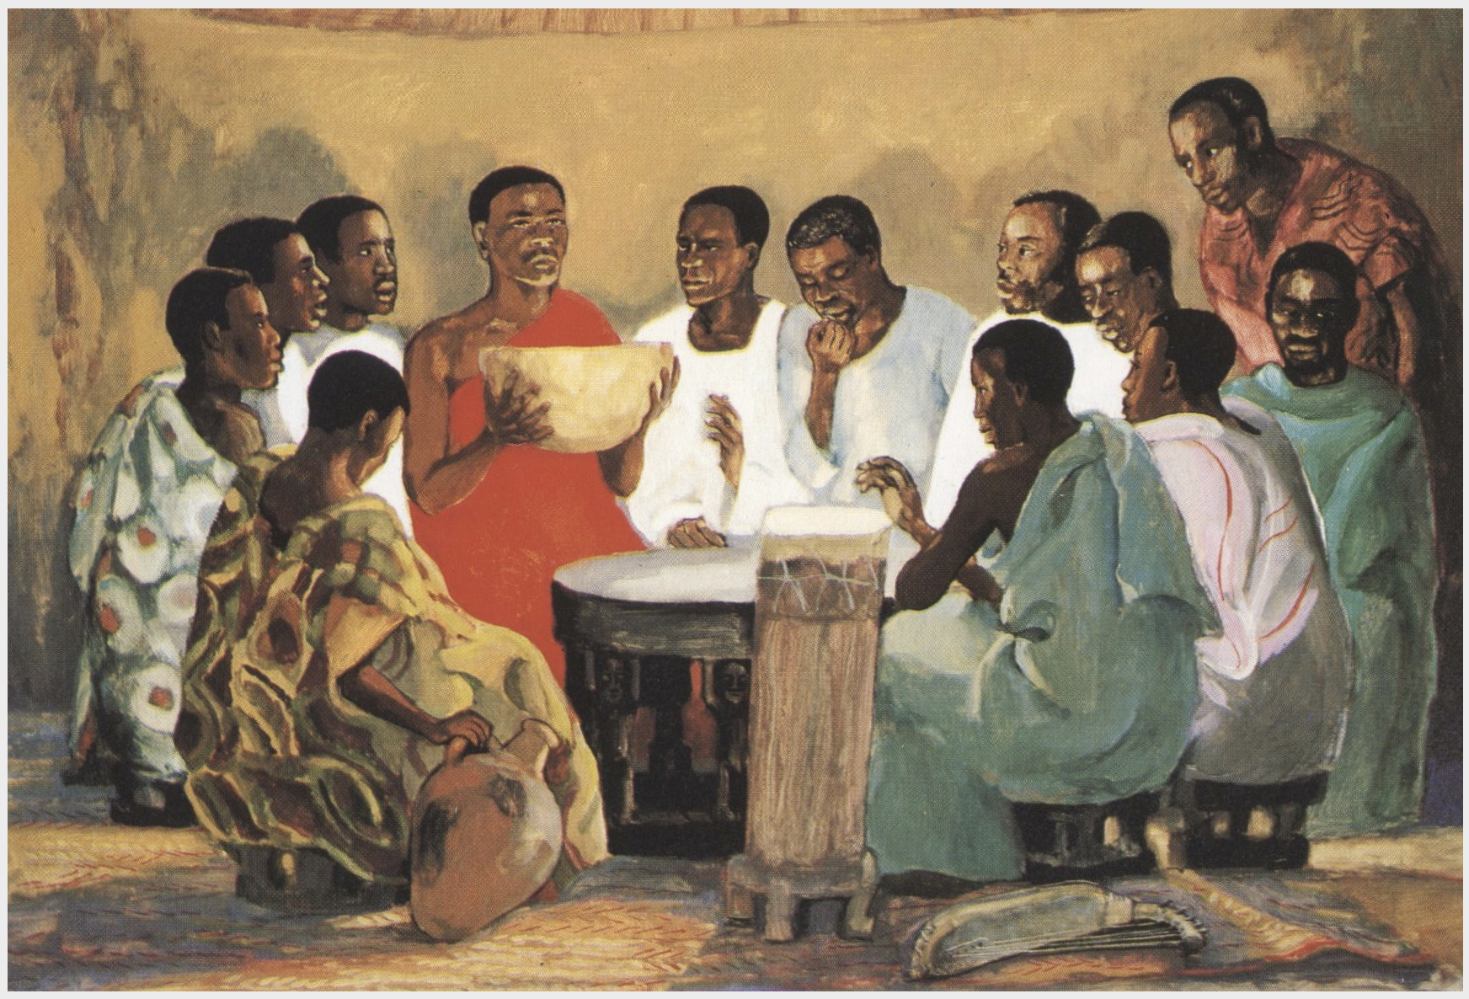
1970s
Jesus Mafa - Cameroon, Africa

Slide 7
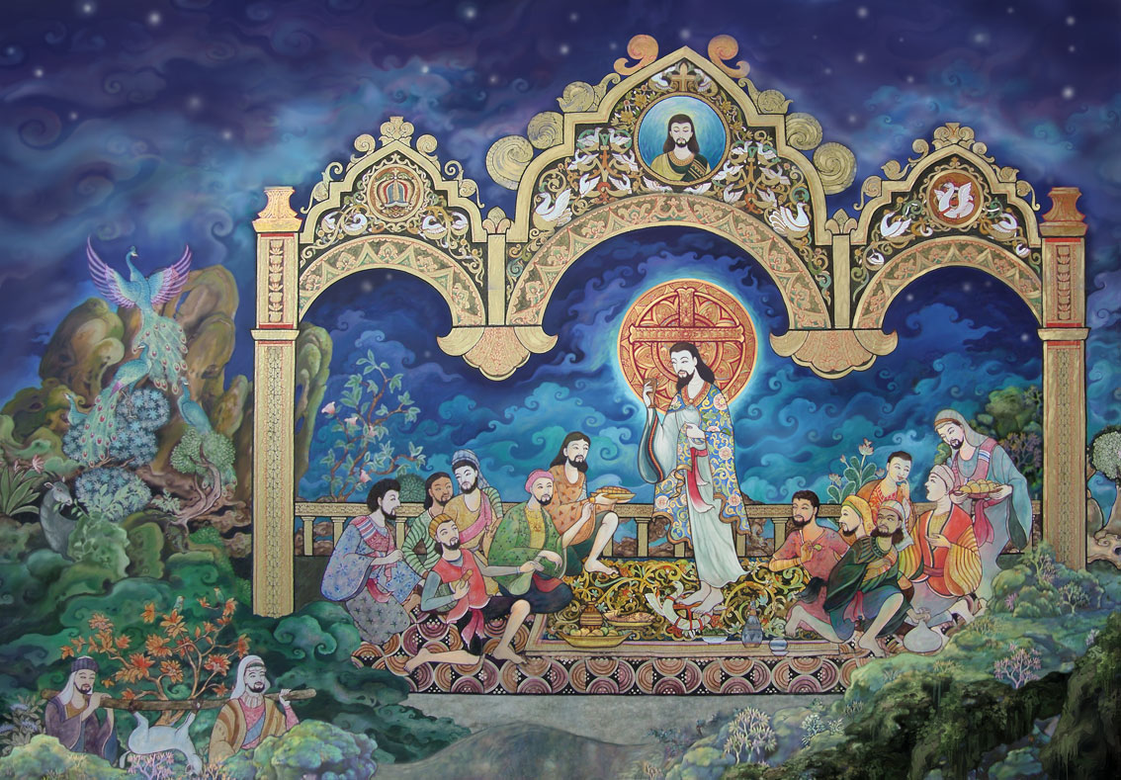
A-thammasak
Thailand
Asia
Early 21st C.

Slide 8

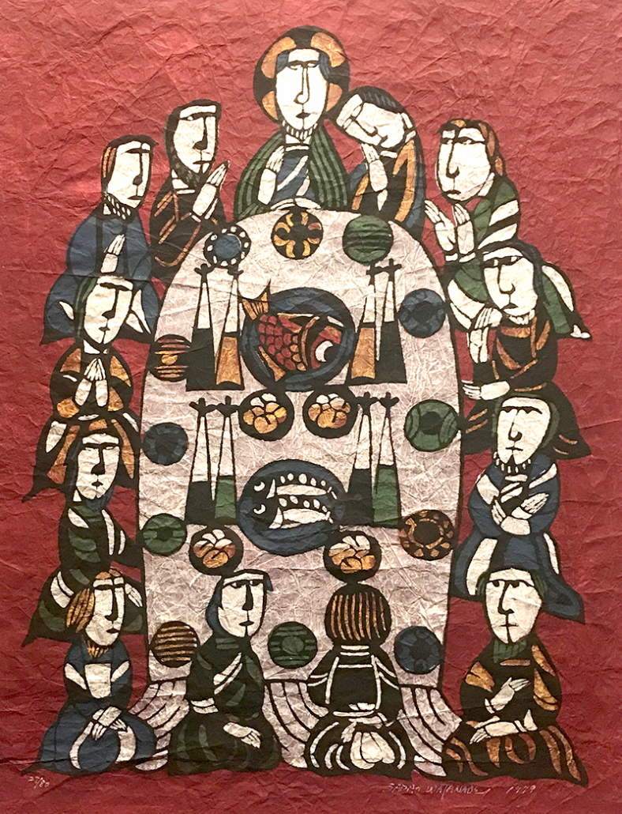
Sadeo Watanabe
20th C
Tokyo, Japan
Asia

Slide 9
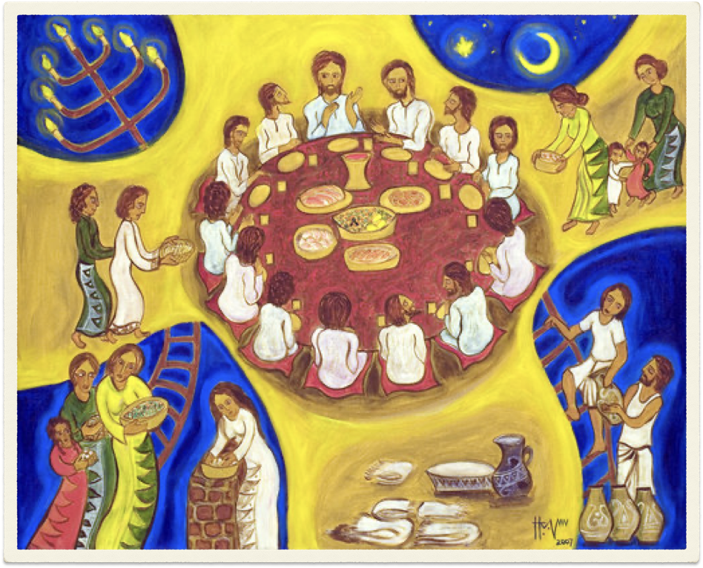
Hanna Varghese - Malaysia, Asia
2017

Slide 10
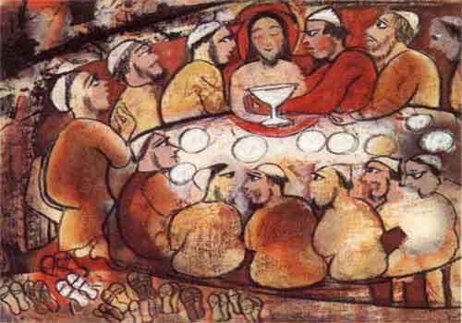
Nalini Jayasuriya
Bali, Asia
2004

Slide 11
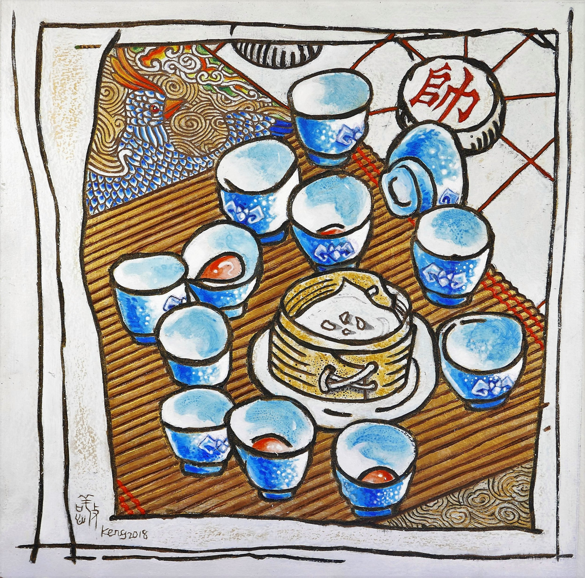
Keng Sen Chong
Malaysia, Asia
2018

Slide 12
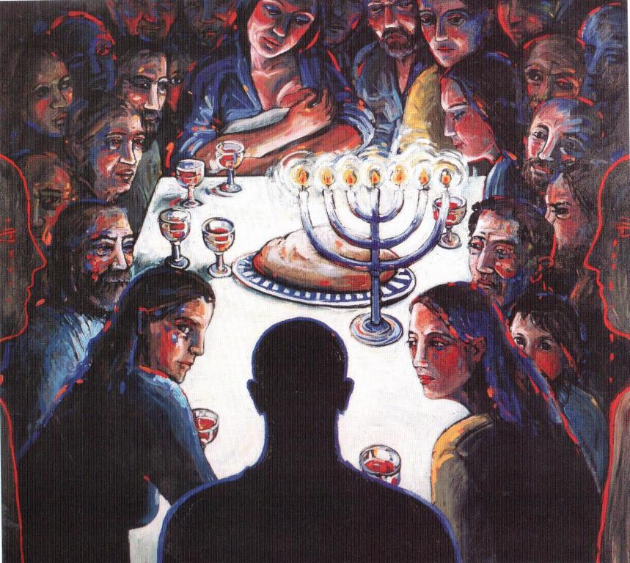
Margaret Ackland
Sydney
Australia
1993

Slide 13
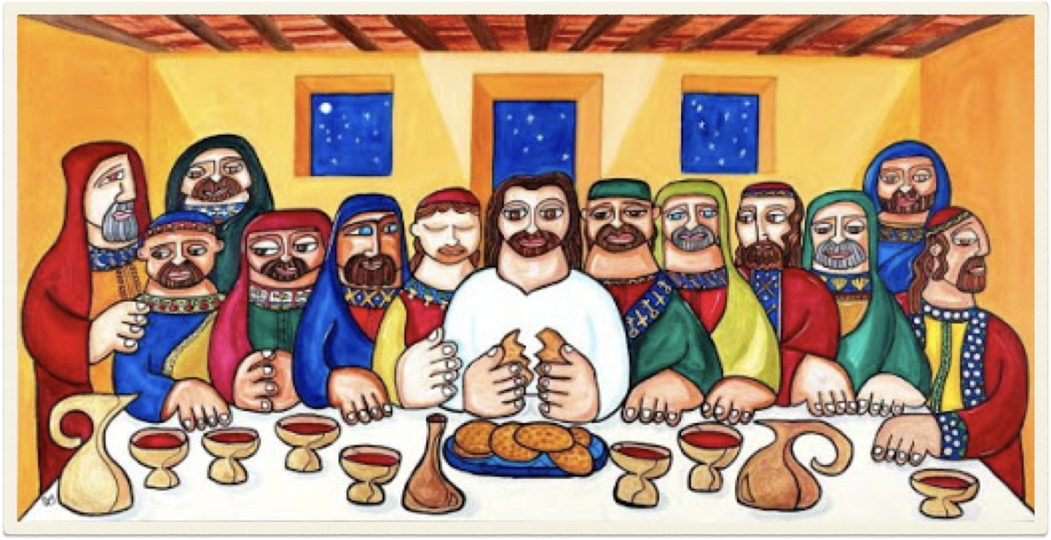
Tony Mendoza
Cuban-American, North America
2000’s

Slide 14
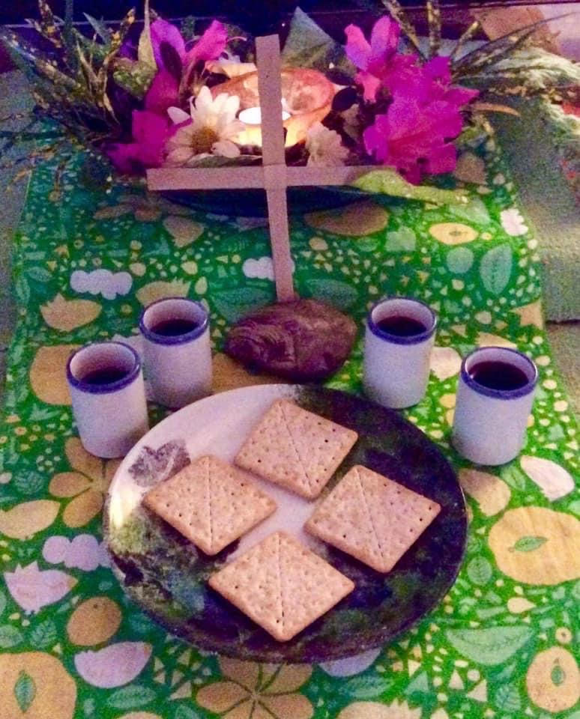
(Juanito Carter & Family)
Caacupé, Paraguay
South America
2020

